Slide 1
Data Transformation Pipeline with Azure Data Factory and Azure Databricks
-Kanak Agrawal
-Akash

Slide 2
Contents
Project Overview
Project Objective
Workflow
Architectural Diagram
Technologies and Tools
Task Performed
Result
Conclusion

Slide 3
Project Overview
Data Transformation Pipeline with Azure Data Factory and Azure Databricks.
Project Objective
The primary objective of this project is to develop a data pipeline that extracts data from a CSV file stored in Azure Storage, transforms it into the Parquet file format, and stores the transformed data in another location. Additionally, Azure Databricks will be used to explore and optimize the conversion process to ensure efficiency and scalability.

Slide 4
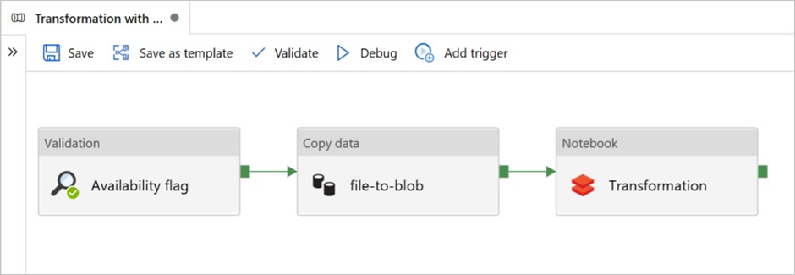
Workflow
Data Extraction
Data Transformation
Data Loading
Monitoring and Optimization
Data Processing
Data Orchestration and Monitoring
Continuous Integration and Deployment(CI/CD)

Slide 5
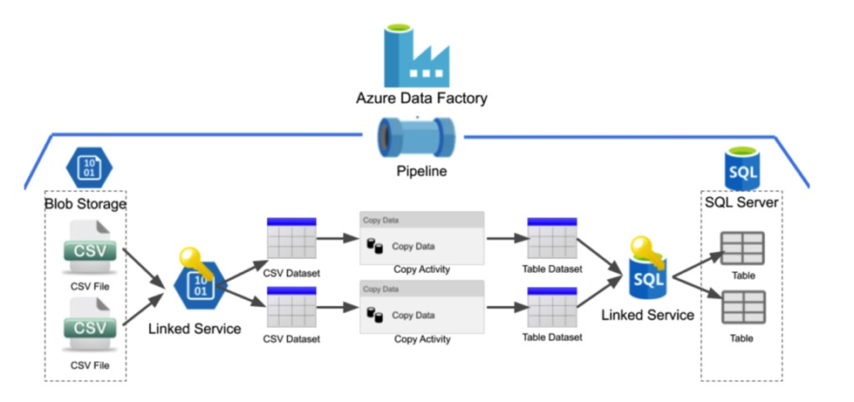
Architectural Diagram
Fig shows the architectural diagram

Slide 6




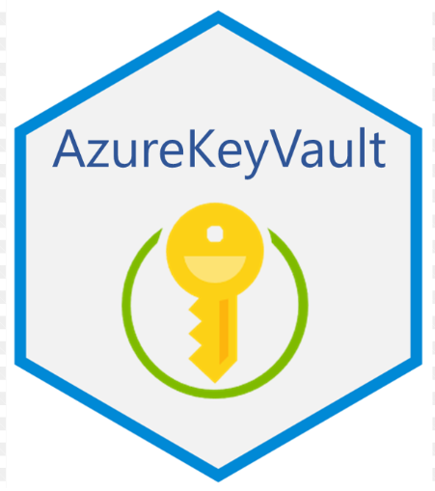
Technologies and Tools
Azure Data Factory
Azure Databricks
Azure Storage
Azure Key Vault
Azure Monitor

Slide 7
Task Performed
1. Extract data from CSV files in Azure Storage.
2. Transform data into Parquet format for optimized storage.
3. Ensure scalability and performance for handling large datasets.
4. Integrate with Azure Data Factory for orchestration.
5. Utilize Azure Databricks for advanced processing and optimization.
6. Implement security measures and ensure compliance.

Slide 8
Task Performed
7. Provide monitoring and alerting functionalities.
8. Offer comprehensive documentation and training.
9. Optimize costs while utilizing Azure resources.
10. Ensure high availability and disaster recovery.
11. Conduct thorough testing for functionality and reliability.

Slide 9
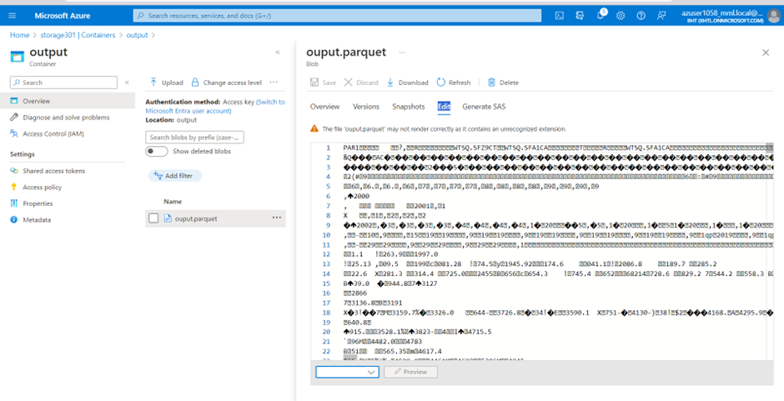
Result
This output shows the CSV file format is transformed into Parquet format

Slide 10
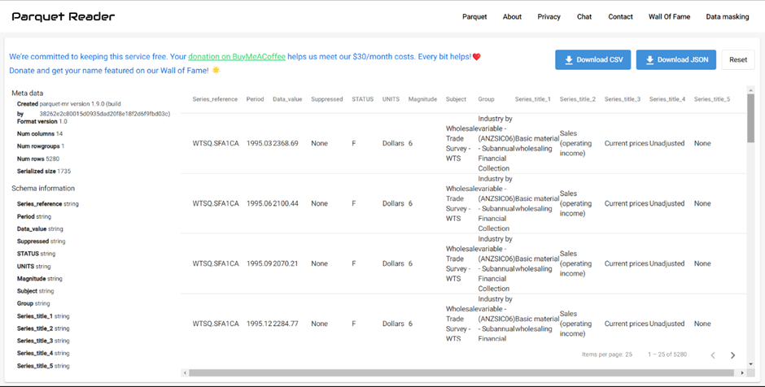
Result
This is the final output of the Paquet format file

Slide 11
Conclusion
This project demonstrates the power of Azure Data Factory in facilitating data-driven decision-making by enabling organizations to extract, transform, and load data from diverse sources into a unified and analytics-ready format. With Azure Data Factory, organizations can streamline their data workflows, accelerate time-to-insight, and unlock the full potential of their data assets to drive business growth and innovation.

